Slide 1
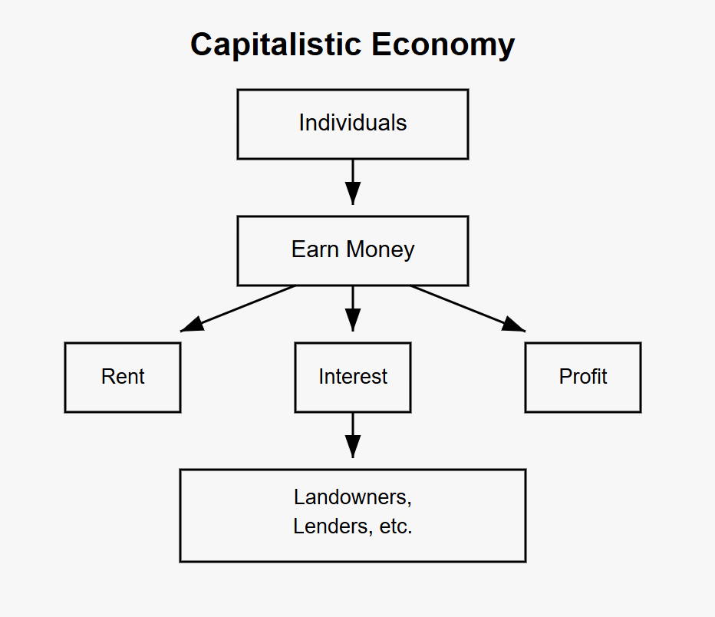
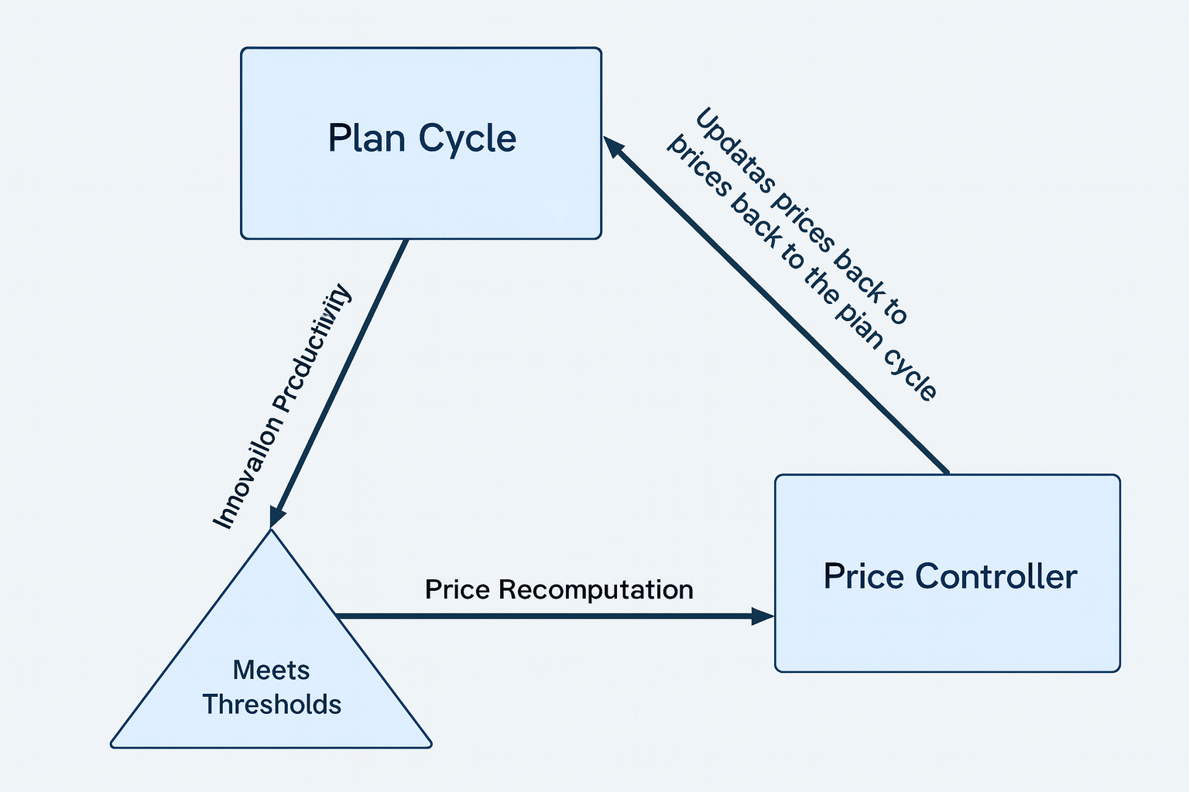
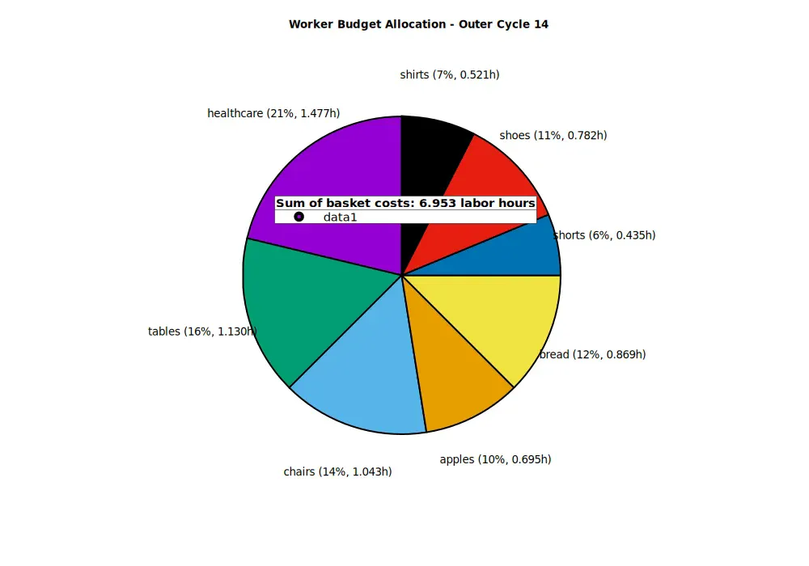
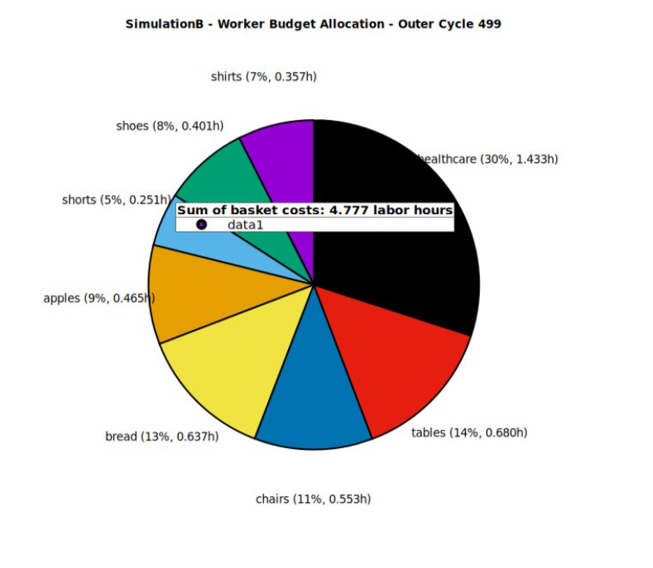
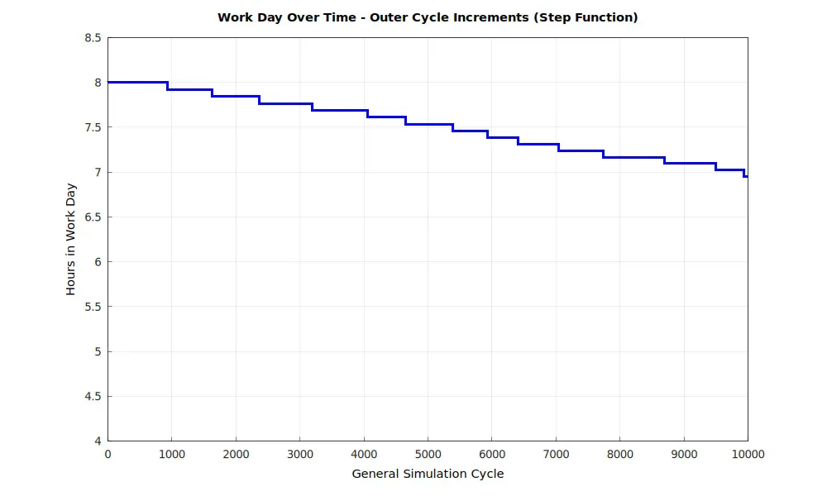
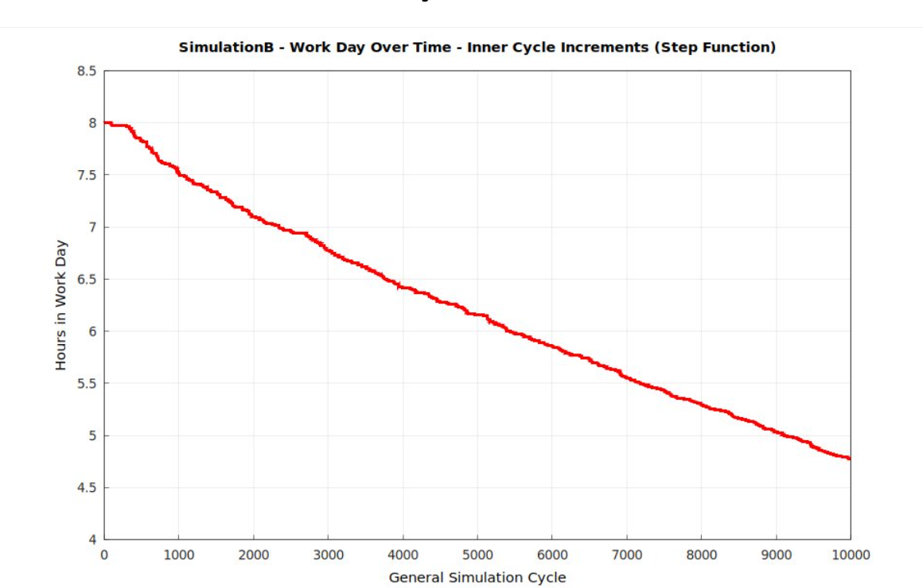
Author(s) – Institution(s)
INTRODUCTION
- Background - Objectives - Motivation
RESULTS
Background
The capitalist productivity paradigm presents a fundamental contradiction where worker innovations primarily benefit capital owners rather than the innovators themselves. As productivity gains increase through technological advancement and process improvements, workers paradoxically face greater job insecurity through layoffs, facility closures, and work intensification. This creates perverse incentives where productivity improvements are systematically discouraged at the worker level, leading to rational resistance behaviors such as concealing efficiency gains to preserve employment.
The core issue can be summarized by the worker's dilemma: "Why should I innovate myself out of employment while enriching others?" Current economic structures fail to align individual worker incentives with collective productivity goals, resulting in suboptimal innovation rates and economic inefficiency.
This research proposes examining a Labor Time Economy model where productivity gains translate directly into reduced working hours for all participants rather than concentrated capital accumulation. Under this framework, innovations would benefit workers through decreased labor requirements while maintaining compensation levels, creating positive incentives for continuous improvement and collective prosperity.
The central challenge is designing economic conditions that encourage rather than discourage productivity improvements over time. While empirical data from Toyota's production system demonstrates that workers spontaneously contribute productivity-enhancing innovations without direct financial incentives, implementing this in a labor-time economy creates additional complexities.
The core problem is preventing workers in sectors with productivity gains from experiencing reduced purchasing power when their required work hours decrease. Two potential solutions were investigated:
(a) System-wide coordination: Ensuring productivity increases occur across multiple sectors simultaneously so that no worker group loses relative buying power compared to others.
(b) Temporal price adjustment mechanism: Allowing more productive sectors to benefit from shorter work schedules while maintaining compensation based on pre-innovation necessary labor time. This requires a controlled price recomputation system where official prices gradually adjust to reflect real costs only after productivity reductions are distributed across sufficient sectors, ensuring equitable distribution of efficiency gains throughout society.
The research challenge is determining which approach maintains both innovation incentives and economic stability while preventing purchasing power disparities between sectors.
The simulation demonstrates a critical difference between controlled and uncontrolled productivity distribution systems. Under the price recomputation mechanism, workers maintain relatively stable purchasing power despite reduced working hours. The step-function graph shows work hours declining from 8.0 to approximately 7.0 hours over 10,000 cycles while worker budget allocation remains balanced across all sectors.
In contrast, the scenario without price recomputation cycles reveals significant purchasing power disparities. Workers in sectors with higher productivity gains experience substantially reduced hours (declining smoothly from 8.0 to under 5.0 hours), but their budget allocation becomes increasingly skewed. Healthcare, which represents a larger portion of the consumption basket, becomes disproportionately expensive relative to workers' reduced labor time, creating an affordability crisis for essential services.
The pie chart evolution illustrates this disparity clearly. With price controls, the basket costs remain manageable (6.953 labor hours in cycle 14 versus 8.000 initially), maintaining proportional access to all goods. Without controls, the basket costs drop dramatically to 4.777 hours, but this creates a two-tier system where workers in less productive sectors cannot afford the same standard of living, particularly for healthcare and other necessities.
This validates the theoretical framework: coordinated price recomputation prevents the purchasing power fragmentation that would otherwise undermine the labor-time economy's equity objectives. The controlled mechanism successfully distributes productivity benefits across the entire workforce rather than concentrating advantages in specific sectors.

